Slide 1

Employee Attrition Analysis
Duy Nguyen

Slide 2

Scope of Discussion
Data modifications
Numerical and categorical correlations
Attrition factors
Income determinants

Slide 3
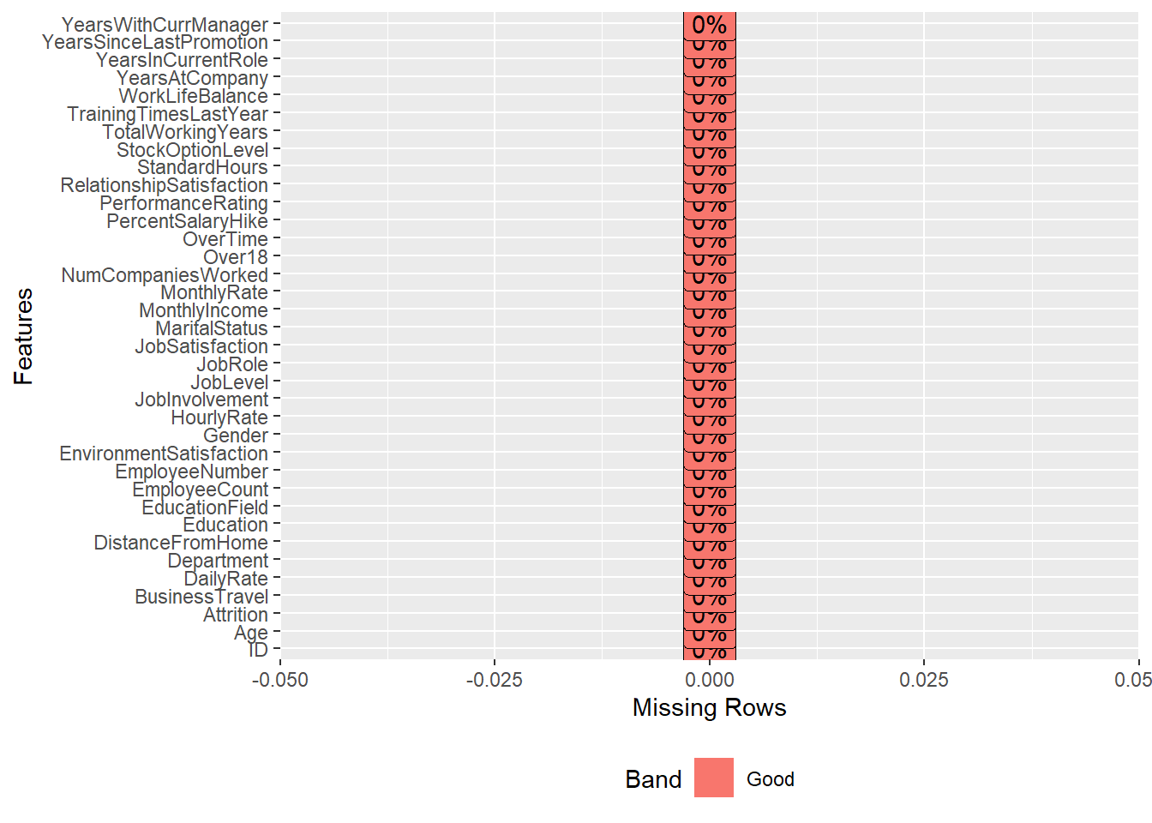
Data Modifications
Missing Values
Zero Variance
EmployeeCount
Over18
StandardHours
Identification
ID
EmployeeNumber

Slide 4
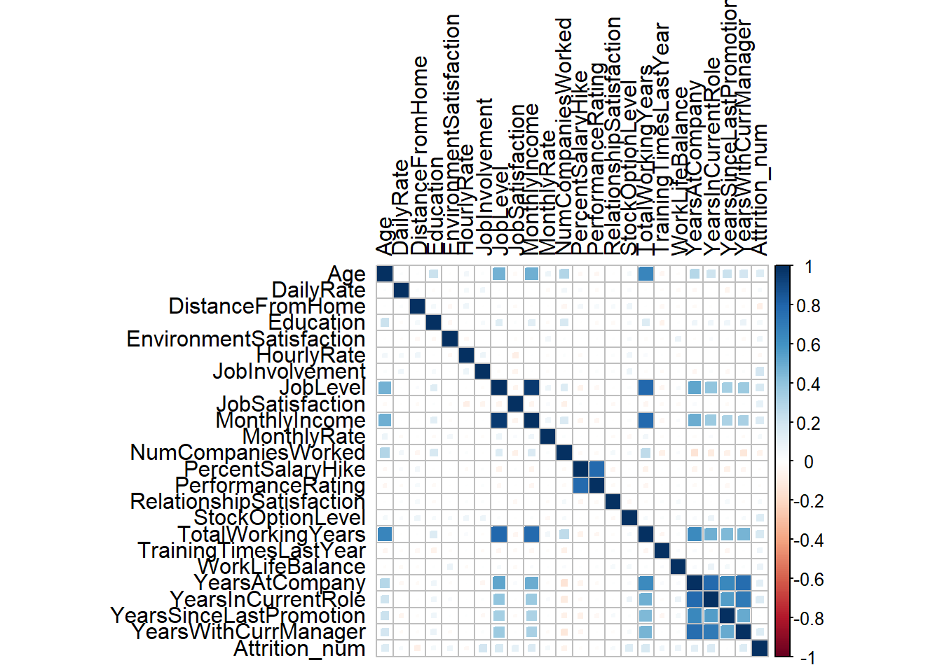
Correlations to Attrition
Age
DailyRate
Education
EnvironmentSatisfaction
JobInvolvement
JobLevel
JobSatisfaction
MonthlyIncome
Month lyrate
RelationshipSatisfaction
StockOptionLevel
TotalWorkingYears
TrainingTimesLastYear
WorkLifeBalance
YearsAtCompany
YearsInCurrentRole
YearsWithCurrManager

Slide 5
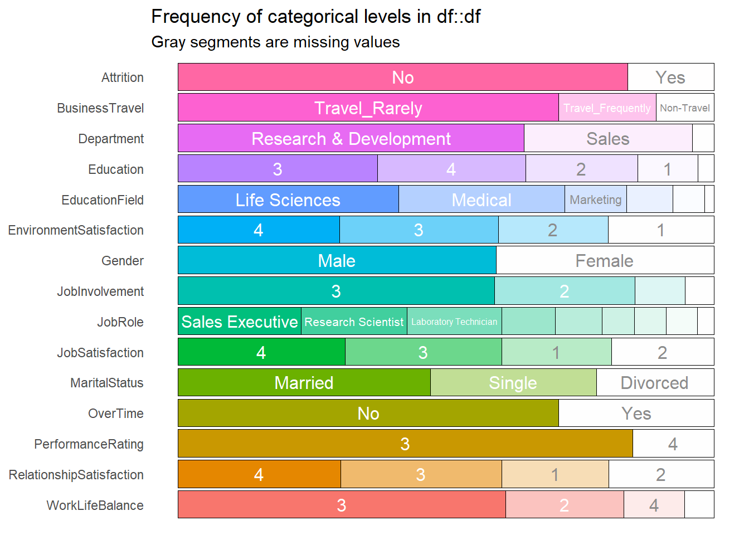
Categorical Variables

Slide 6
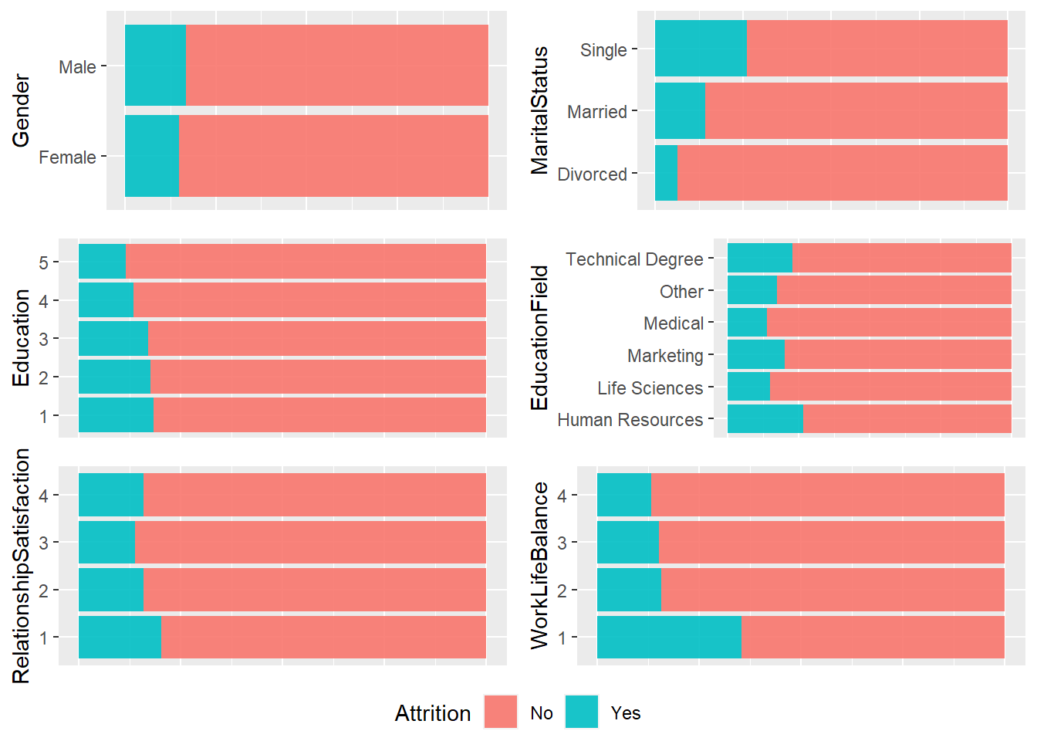
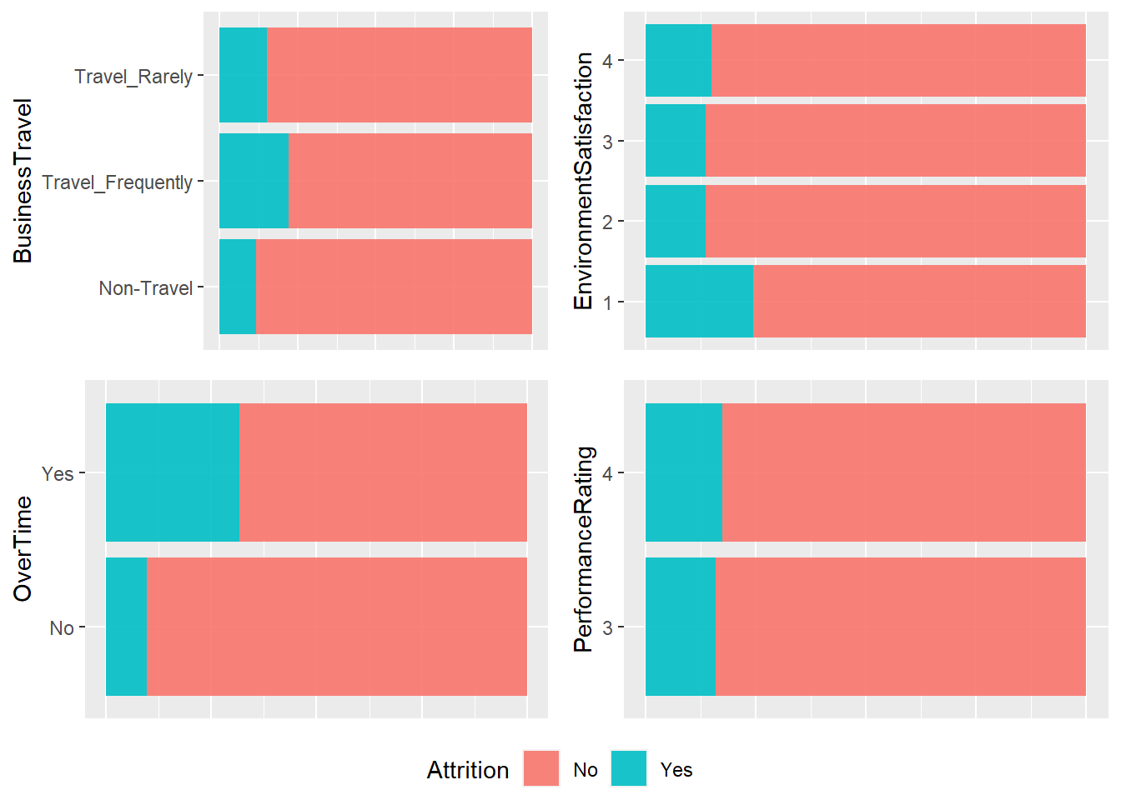

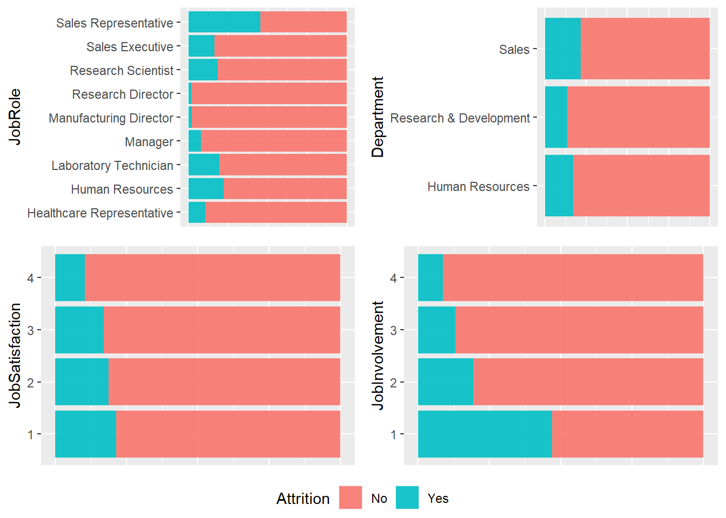
Categorical Metrics

Slide 7
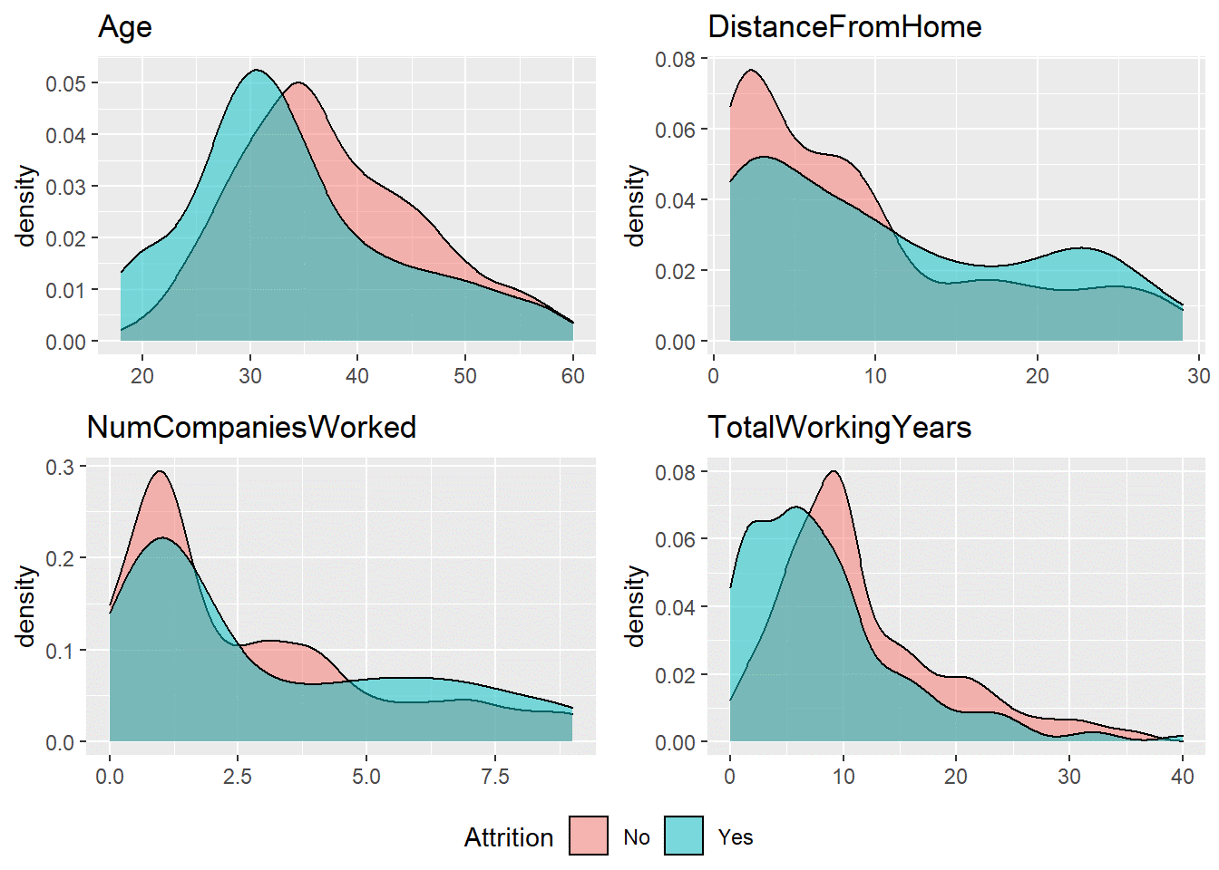

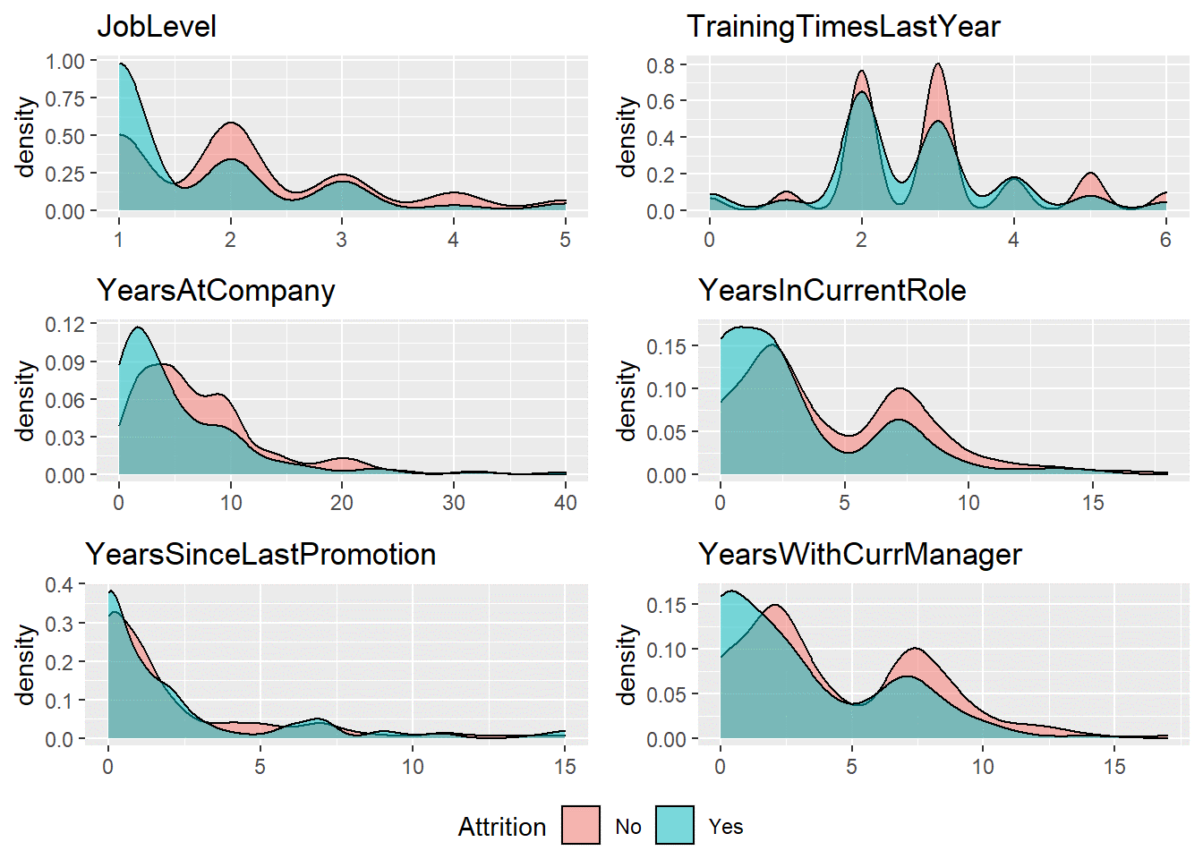
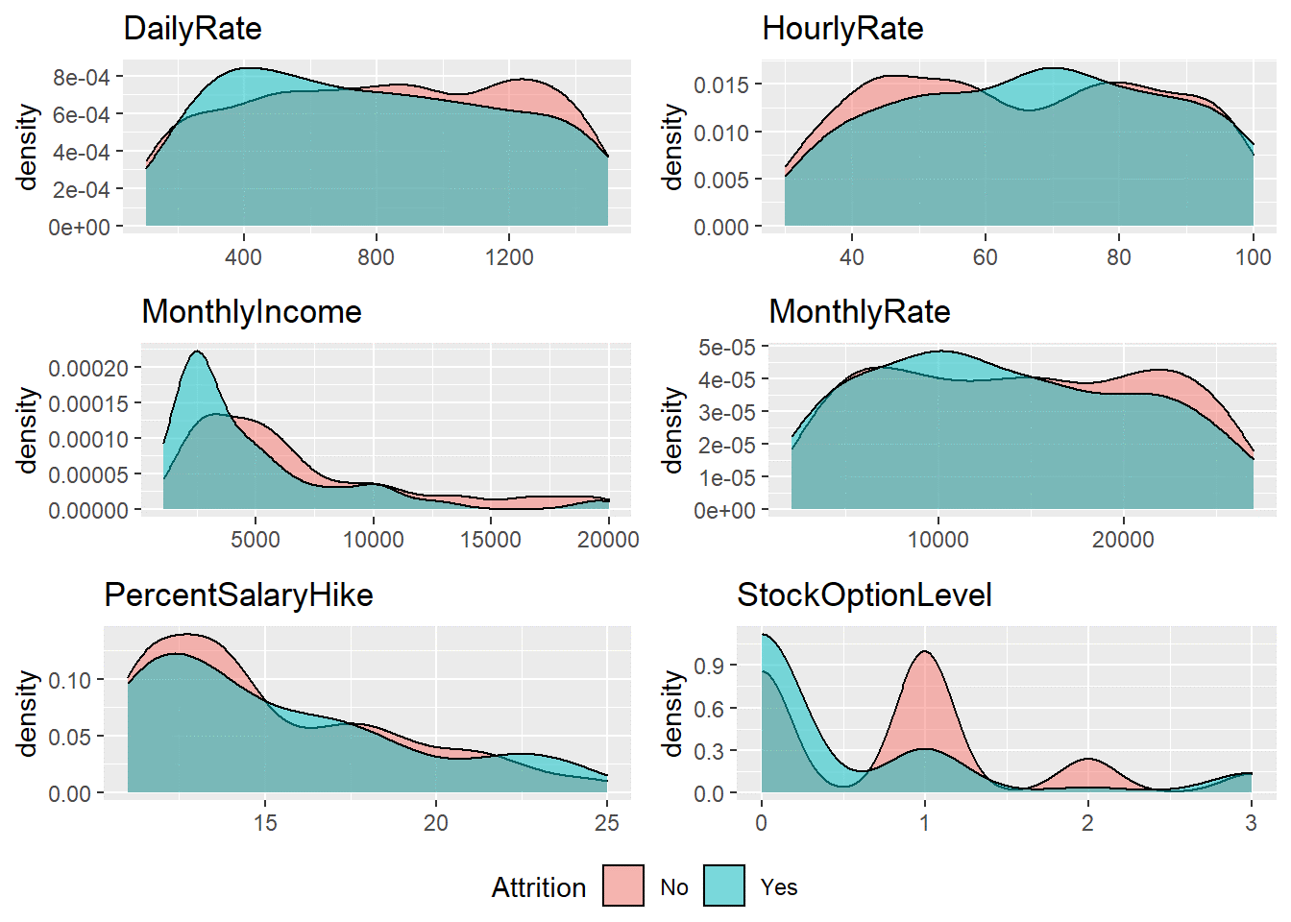
Numerical Metrics

Slide 8
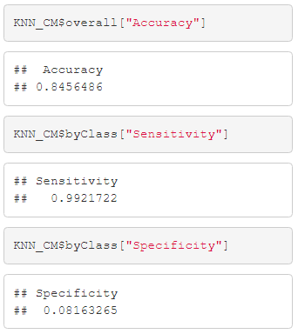
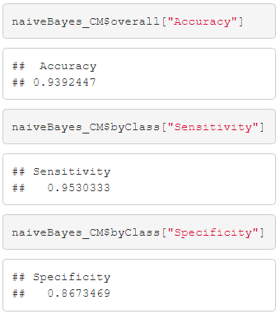
Predicting Attrition
k-Nearest Neighbors versus Naïve Bayes

Slide 9
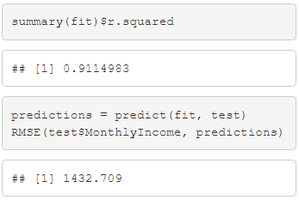
Predicting Monthly Income
Linear Regression
Age
Education
JobLevel
MonthlyRate
NumCompaniesWorked
TotalWorkingYears
YearsAtCompany
YearsInCurrentRole
YearsSinceLastPromotion
YearsWithCurrManager

Slide 10
Thank You.
Duy Nguyen
duynq@mail.smu.edu

Slide 11
Presentation Video Link
Duy Nguyen - https://youtu.be/uuPV2oC6M5s

